Slide 1
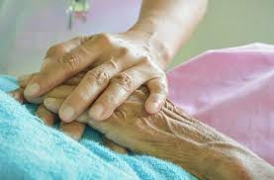

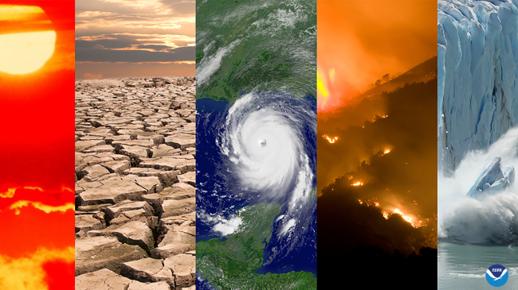

FBFSEU Member Benefits
Sub-committee members:
Kinijoji Bakoso (FDB) (Chairman of sub-committee)
Sakiusa Nabou (RBF)
Nilesh Karan (SCGF)
Arishma Singh (HFC)
Hina Khan (ANZ) - Outgoing

Slide 2
\
Your subscription of $6 entitles you to Union benefits (conditions apply)

Slide 3
Death
Disasters (Fire, Floods, Earthquake
Retirement, Redundancy, Retrenchment
or De-establishment of roles
National Sporting Duties
What are these benefits?

Slide 4
DEATH BENEFIT
Eligibility Amounts
  Member(s) Death – $1000
  Spouse and Children – $1000
  Single Member (Death of a parent) – $1000
  Married members Parents/Legal Guardian – $500
Eligibility Criteria
  Must be a member of the FBSEU and Claim within 1 year of death taking place.
  Death benefit application form to be vetted by Union rep with proof of marital status and who benefit is to be paid to incase of death of a member.
  Provide the following:-
    Notification of death / Death Certificate for deceased
    Legal Guardian – Statutory Declaration confirming legal guardian.
    Birth certificate in case of children, Marriage certificate in case of spouse or Member (if applicable)
    ID of person collecting benefit, method of payment and Bank Account details. Authority by member if collection by third party.
  Two applications only for parents’ death – Father and Mother whether guardian or biological.
Exclusions
1. Parents (in-laws) of members are not eligible.
2. Any violation of the FBSEU policies and constitution.
3. Members in 4 weeks arears of subscription to clear his/her arears before claiming benefit.

Slide 5
Retirement, Redundancy, Retrenchment or De-establishment of roles
Eligibility Amounts (based on years of Union membership)
  5 – 10 years – $500
  11 – 15 years – $750
  16 – 20 years – $1000
  21 years plus – $2000
Eligibility Criteria
  Must be a member of the FBFSEU.
  Fill retirement benefit form and detail Bank account details.
  Provide retirement letter from organization.
  Have reached retirement or early retirement and are of age between 45 – 55
  If affected by restructure, retrenchment or redundancy (no age restrictions).
  Retirement on medical ground before reaching the age cap – $500 irrespective of membership term.
Note: Members who have left the FBFSEU and wanting to rejoin again, their membership will start again from being a new member and their previous membership years will not accumulate from when they left.
Pre-Qualification Requirement
  Letter from organization stating rretirement, early retirement, retrenchment or redundancy.
  Authority by member if collection by third party.
Exclusions
  Any violation of the FBSEU policies and constitution.
  Members 4 weeks in arears of subscription shall fully clear his/her arears before claiming benefits.

Slide 6
Disaster Benefit
Eligibility Amount
  On merit – maximum of $1000 per annum per applicant
  Cyclone, Earthquake and Tsunami – $250 Secretariat limit.
  Floods – $250 Secretariat limit.
  Fire – $250 Secretariat limit.
Eligibility Criteria
  Must be a member of the FBFSEU.
  Disaster of any form. Natural (geophysical, hydrological, climatological or meteorological disasters) or man-made (fires)
  Must be a member at the time of event
  Claim withing 1 year of event taking place
Pre-Qualification Requirement
  Advice by member or Union rep.
  Extent of damage and, or evidence of disaster (e.g. Police/NFA report – Fire) and as requested under cyclone damage.
  Confirmation by Union Rep – who the benefit will be paid to and method of payment and Bank Account details required. Authority by member if collection by third party.
  Disaster Assessment Form (Assessment officer and member to sign off assessment report)
Exclusions
  Any violation of the FBSEU policies and constitution.
  Members 4 weeks in arears of subscription shall fully clear his/her arears before claiming benefits.

Slide 7
National Sporting Duties Benefits
Eligibility Amount
  Max $500 per annum per member
Eligibility Criteria
  Must be a member of the FBFSEU.
  Members representing Fiji National side on overseas tour or local sporting event.
Pre-Qualification Requirement
  Evidence of participation and endorsement from National Sports Federation endorsement
  Fill benefit application form stating Bank account details.
  Authority by member if collection by third party.
Exclusions
  Any violation of the FBSEU policies.
  Members 4 weeks in arrears of subscription shall fully clear his/her arrears before claiming benefits..
  New Members joining the FBFSEU and wanting to claim the benefit on the basis of the 1-year benefit claim but were not FBFSEU member at the time of the sporting event.

